Slide 1
Biofuel Group Tech Review
Renlong Zheng
Jingtian Zhang
Cheng Zeng
Chenggang Xi

Slide 2
Background
QSPR studies are aimed at developing correlation models using a response of biofuels (property) and chemical information data in a statistical approach
Molecular structures descriptors can be extracted from DIPPR database.
Thermal properties can be found in Materials Studio/Aspen plus/several papers.
Classification-based approaches are employed when categorization of the data points into several groups or classes such as highly active and less active.
The regression-based methods enable the quantitative prediction of the response (activity/property).
Notes:
Study
From
Then we should use ML methods to deal with the data
Diff group by famil type, fu group, beca they may have com pro in the same
To explore the relationship b s and pro

Slide 3
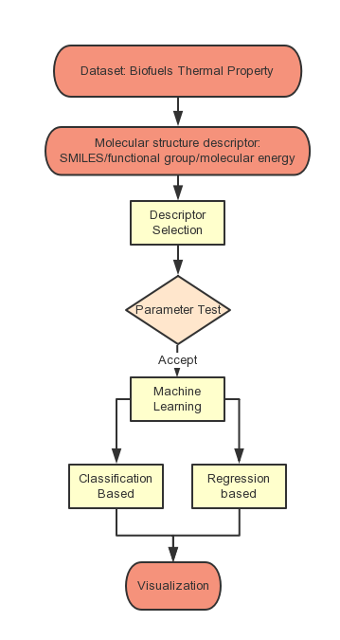
Methods will be used
Regression-based chemometric tools
Multilinear Regression (MLR)
Partial Least Squares (PLS)
Classification-based chemometric tools
Linear Discriminant Analysis (LDA)
Cluster Analysis (CLA)
Other approaches
Graph machine method(SMILES)
Parameter test(T/Z-testing)
Notes:
Work flow of our proj
Collect data fr web or sfw dabase
B there are so many desc ,we should Chose data column_ t_testing
Different family _ classification/graph
In one type of family _ regression
graph machine method
simplified molecular input line entry specification (SMILES) formulas

Slide 4

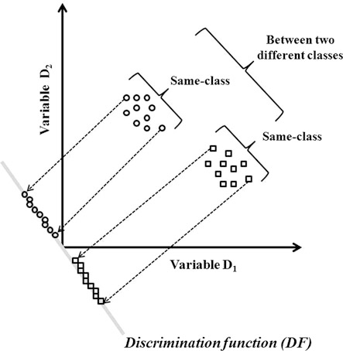
Classifier Machine Learning: LDA
Scikit learn is used for machine learning portion
Linear discriminant analysis (LDA)
discriminant_analysis.LinearDiscriminantAnalysis
Classification is identifying group membership.
DF =C1*X1+C2*X2+......+Cn*Xn+a
LDA explicitly intends to model the differences between classes of data
DF is the discriminant function, which is a linear combination (sum) of the discriminating variables
c is the discriminant coefficient or weight for that variable, large c means good predictors
X is respondent’s score for that variable
a is a constant
n is the number of predictor variables.
From : www.springer.com/cda/content/document/cda.../9783319172804-c2.pdf?SGWID=0...
Notes:
These c’s maximize the distance between the means of the criterion (dependent) variable.
Good predictors tend to have large standardized coefficients.
After using an existing set of data to calculate
the DF and classify cases, any new cases (test samples) can then be classified.

Slide 5
Classifier Machine Learning: Cluster
Cluster Analysis
Do not require to know elements belong to which cluster
Cluster analysis maximizes the similarity of cases within each cluster while maximizing the dissimilarity between groups that are initially unknown.
There are many types
Connectivity based
Centroid based - k mean clustering
Distribution based
Density based - DBSCAN
Instance based - KNN
Notes:
The hierarchical cluster analysis finds relatively homogeneous clusters of cases
based on dissimilarities or distances among objects.

Slide 6
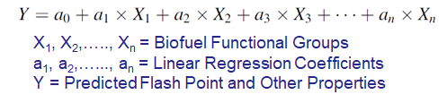

Multilinear Regression
Multiple Linear Regression (MLR):
Ridge
LASSO
To determine the adjustable parameter 𝝀, we observed the significant of each regression coefficient at P < 0.05.

Slide 7
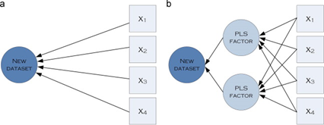
Multilinear Regression Contd.
Partial Least Square Regression (PLS):
It involves secondary components, PLS Factors
As the number of PLS Factor increases, PLS regression become the same as MLR

Slide 8
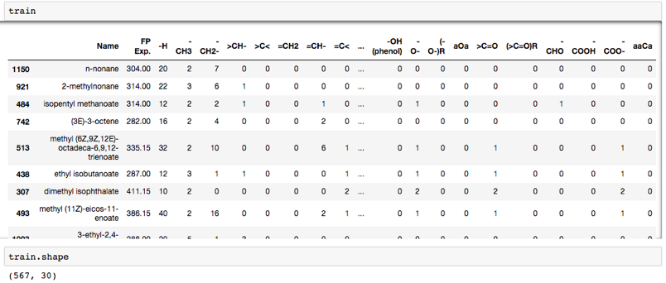
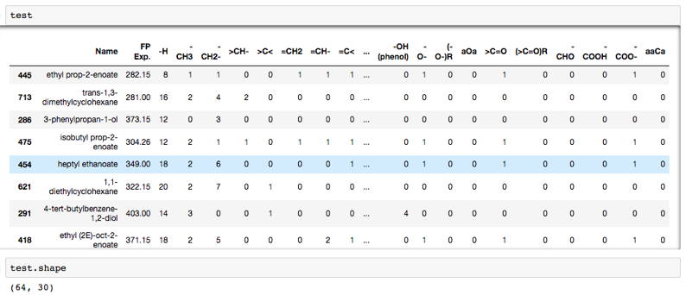
Eg. Data → Training and Testing
Testing data

Slide 9
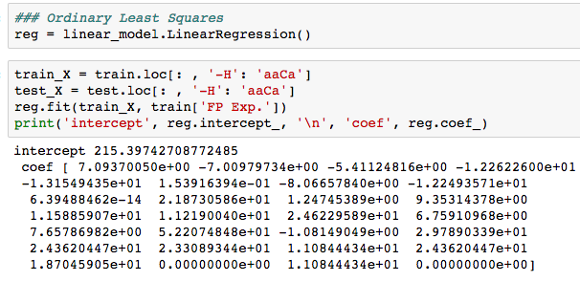
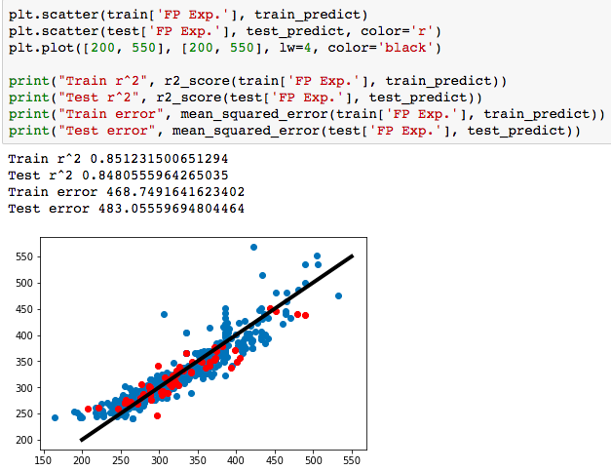
Multiple Linear Regression
Ordinary Least Squares (Use all functional groups as descriptors)
Each regression coefficient should be significant
at p < 0.05 which can be checked from a ’t’ test.
Parity plot

Slide 10
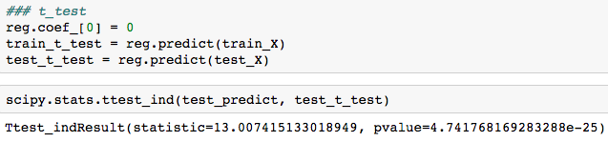
T-test
The null hypothesis: reg.coef_[0] = 0
P value < 0.05
So the null hypothesis is rejected,
reg.coef_[0] != 0
The first descriptor is significant to the relation.
Next step:
Iterate, iterate, iterate

Slide 11
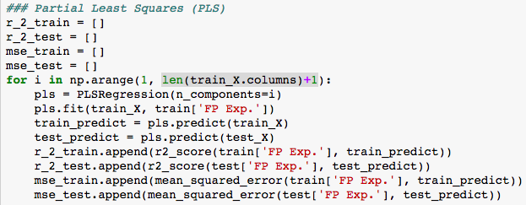
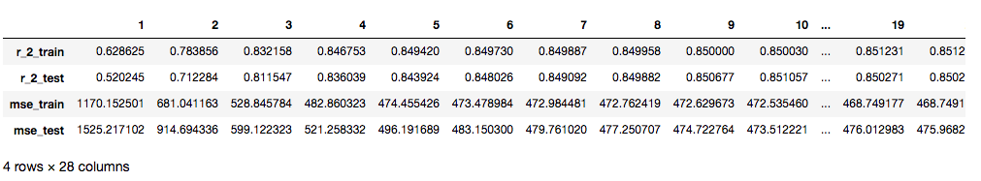
Partial Least Squares (PLS) (Choose components to decide descriptors)
It seems when components increase, the r_2 becomes larger, and mse becomes smaller.
When components are larger than 5, the prediction seems stable.

